Slide 1
A MAJOR PROJECT
On
REVOLUTIONIZING ADS WITH MOBILE VEHICLES CAMPAIGNS (PRC-3)
BACHELOR OF TECHNOLOGY
IN
CSE- AI & ML
BY
21VE1A66A4 N. Karthikeya Goud
21VE1A66B9 Syed Salman
22VE5A6609 G. Sharat
21VE1A66A9 S. Siri
Under the Guidance of
Dr. Swathi Gowroju
Associate professor
ACADEMIC YEAR: (2024-2025)
)

Slide 2
REVOLUTIONIZING ADS WITH MOBILE VEHICLES CAMPAIGNS
CONTENTS
Abstract
Proposed System
Literature survey
S/w & H/w requirements
System Architecture
UML Diagrams
Dataset
Modules Description
Module wise Results (Screenshots)
Applications of proposed system
Conclusion
References
Queries

Slide 3
Abstract
In today’s fast-paced world, traditional advertising methods often fail to capture the attention of the right audience at the right time. This project, titled “Revolutionizing Ads with Mobile Vehicles Campaigns”, aims to make advertising smarter and more dynamic using real-time object detection. The system uses a live camera feed to monitor traffic, and with the help of the YOLOv8 deep learning model, it detects and counts vehicles passing by. Based on the vehicle density, the system intelligently selects and displays relevant advertisements. The entire process is controlled and viewed through a simple web interface. By adapting the advertisement content to real-world conditions, this project enhances the effectiveness of mobile billboard campaigns, ensuring that ad displays are more targeted, timely, and engaging.

Slide 4
Prposed System
The proposed system is designed to enhance mobile advertising by making it intelligent and responsive to real-time traffic conditions. It uses a live camera, typically mounted on a vehicle or roadside, to continuously capture video of the surrounding area. These video frames are processed using the YOLOv8 object detection model, which accurately detects and counts vehicles such as cars, buses, and trucks. Based on the number of vehicles detected, the system selects an appropriate advertisement from a predefined set—low-traffic areas display basic ads, medium traffic areas display mid-range ads, and high-traffic conditions trigger premium ad content. The selected advertisement, along with the live video feed, is then displayed on a web-based interface accessible to users. The system allows for real-time control, enabling users to start or stop the operation and monitor the outputs.

Slide 5
LITERATURE SURVEY
1.PAPER TITLE : Combining YOLO and Visual Rhythm for Vehicle Counting
AUTHORS : Victor Nascimento Ribeiro, Nina S. T. Hirata
DESCRIPTION OF PROPOSED ALGORITHMS:
This study introduces an efficient vehicle counting method by integrating YOLO for detection with Visual Rhythm, a technique that emphasizes key video frames, eliminating the need for tracking.
RESULTS OBTAINED BY AUTHORS: Achieved a mean counting accuracy of approximately 99.15% and a processing speed three times faster than traditional tracking-based methods.
2. PAPER TITLE : Design and Implementation of Road Vehicle Counting Model Based on YOLOv8
AUTHORS : Md Golam Morshed ,Tangina Sultana Aftab Alam andYoung-Koo Lee
DESCRIPTION OF PROPOSED ALGORITHMS:
Proposes a road vehicle counting model utilizing YOLOv8, incorporating Kalman filtering for tracking and irrelevant region masking to enhance counting accuracy.
RESULTS OBTAINED BY AUTHORS: Demonstrated stable performance with high accuracy 95%, precision, recall, and F1 scores, effectively determining road congestion levels.
.

Slide 6
CONTINUED LITERATURE SURVEY
3. PAPER TITLE : Vehicle Counting in Drone Images: An Adaptive Method with Spatial Attention and Multiscale Receptive Fields
AUTHORS : Yu Liu, Hang Shen, Tianjing Wang, Guangwei Bai
DESCRIPTION OF PROPOSED ALGORITHMS:
Develops an adaptive vehicle counting method for drone images, employing spatial attention mechanisms and multiscale receptive fields to enhance detection accuracy.
RESULTS OBTAINED BY AUTHORS: Achieved significant improvements in counting accuracy, making it suitable for aerial traffic monitoring applications.
4. PAPER TITLE : Evaluating the Significance of Outdoor Advertising from Driver's Perspective Using Computer Vision
AUTHORS : Zuzana Černeková, Zuzana Berger Haladová, Ján Špirka, Viktor Kocur
DESCRIPTION OF PROPOSED ALGORITHMS: Introduces a pipeline for assessing the impact of roadside billboards on drivers, utilizing eye-tracking data and YOLOv8 for object detection to classify billboard significance.
RESULTS OBTAINED BY AUTHORS: The system demonstrated 97.5% accuracy.

Slide 7
Software / Hardware Requirements
Software Requirements:
Operating System: Windows 10 or higher
Technology: Python, Machine Learning, Deep Learning, Flask,pytorch
Software: Jupyter, VS Code, or PyCharm
Hardware Requirements:
Processor: Intel i3 or higher
Operating System: Windows
RAM: At least 4 GB
Hard Disk: At least 100 GB storage

Slide 8
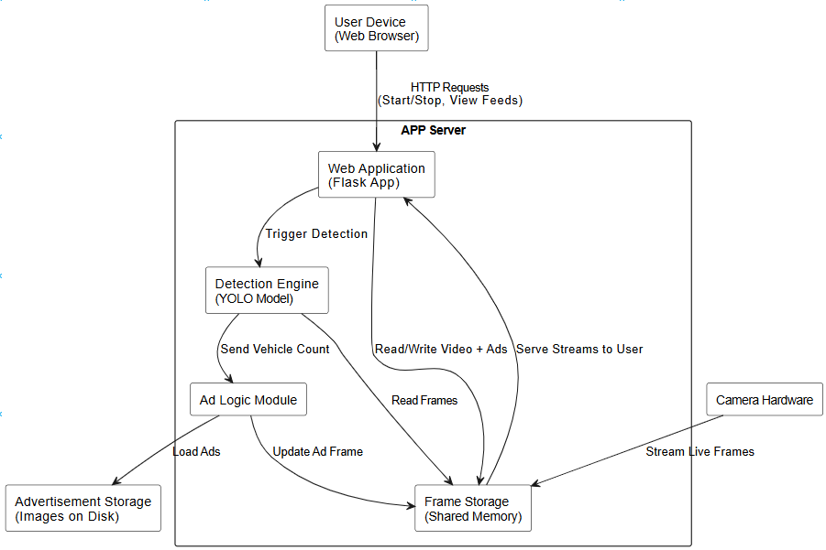
System Architecture

Slide 9
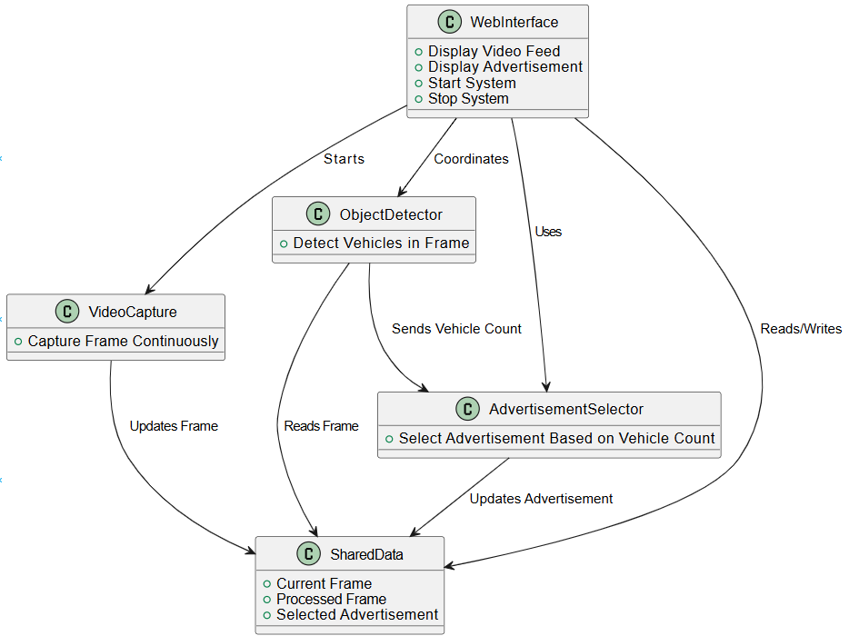
Uml diagrams CLASS DIAGRAM

Slide 10
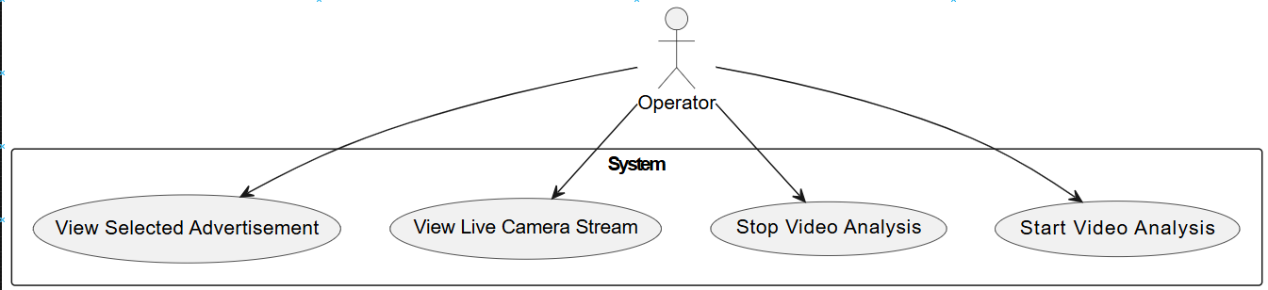
Uml diagrams USE CASE DIAGRAM

Slide 11
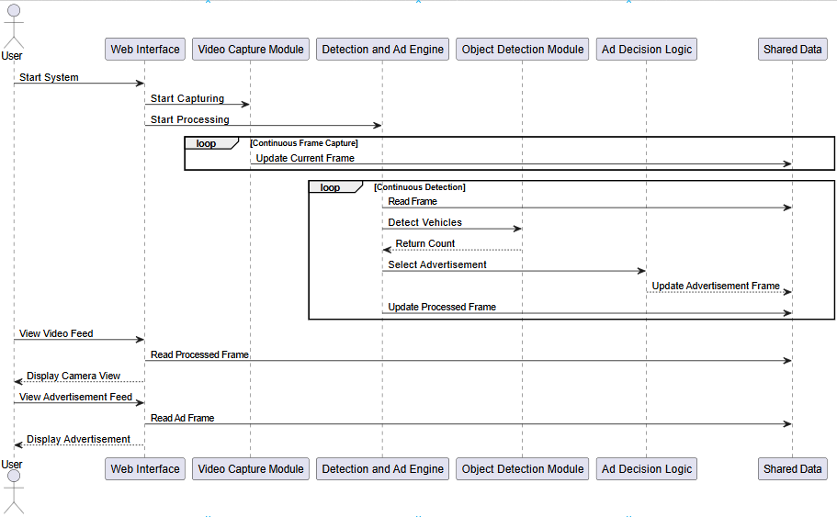
Uml diagrams SEQUENCE DIAGRAM

Slide 12
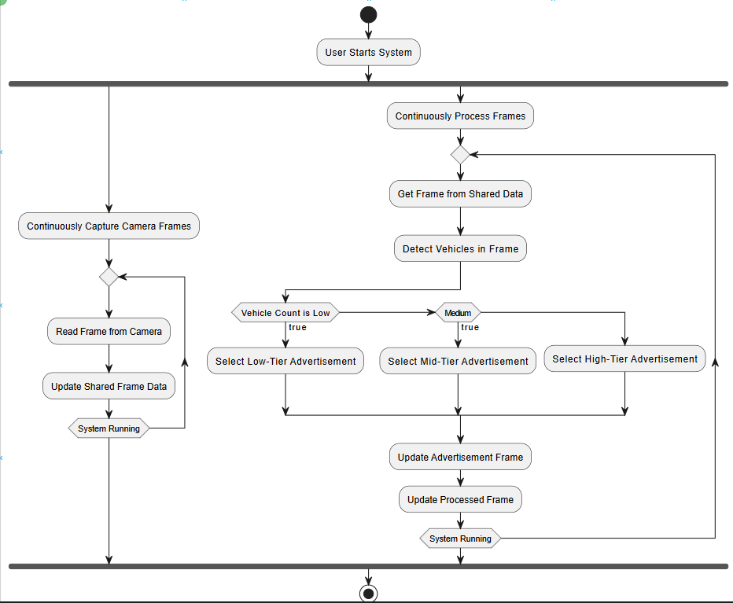
Uml diagrams aCTIVITY DIAGRAM

Slide 13
Dataset
COCO - Common Objects in Context

Slide 14
Modules Description
User Interface (UI):
Lets the user start or stop the system and view both the live traffic video and the selected advertisement on a webpage.
Camera Module:
Captures live video from the road using a camera. It sends these video frames for further processing to detect vehicles.
Vehicle Detection Module:
Uses the YOLOv8 model to detect and count vehicles like cars, buses, and trucks in each frame of the live video.
Ad Decision Module:
Chooses the right advertisement based on how many vehicles are detected. Fewer vehicles show basic ads; more vehicles show premium ads.

Slide 15
Modules Description
Ad Storage Module:
Stores all advertisement images in different categories such as low, medium, and high. The system picks the right ad from here.
Streaming Module:
Streams both the live video and the selected advertisement to the browser in real time so the user can see everything live.
Shared Data Module:
Temporarily stores the latest video frame and the selected ad so that other parts of the system can use or update them quickly.

Slide 16
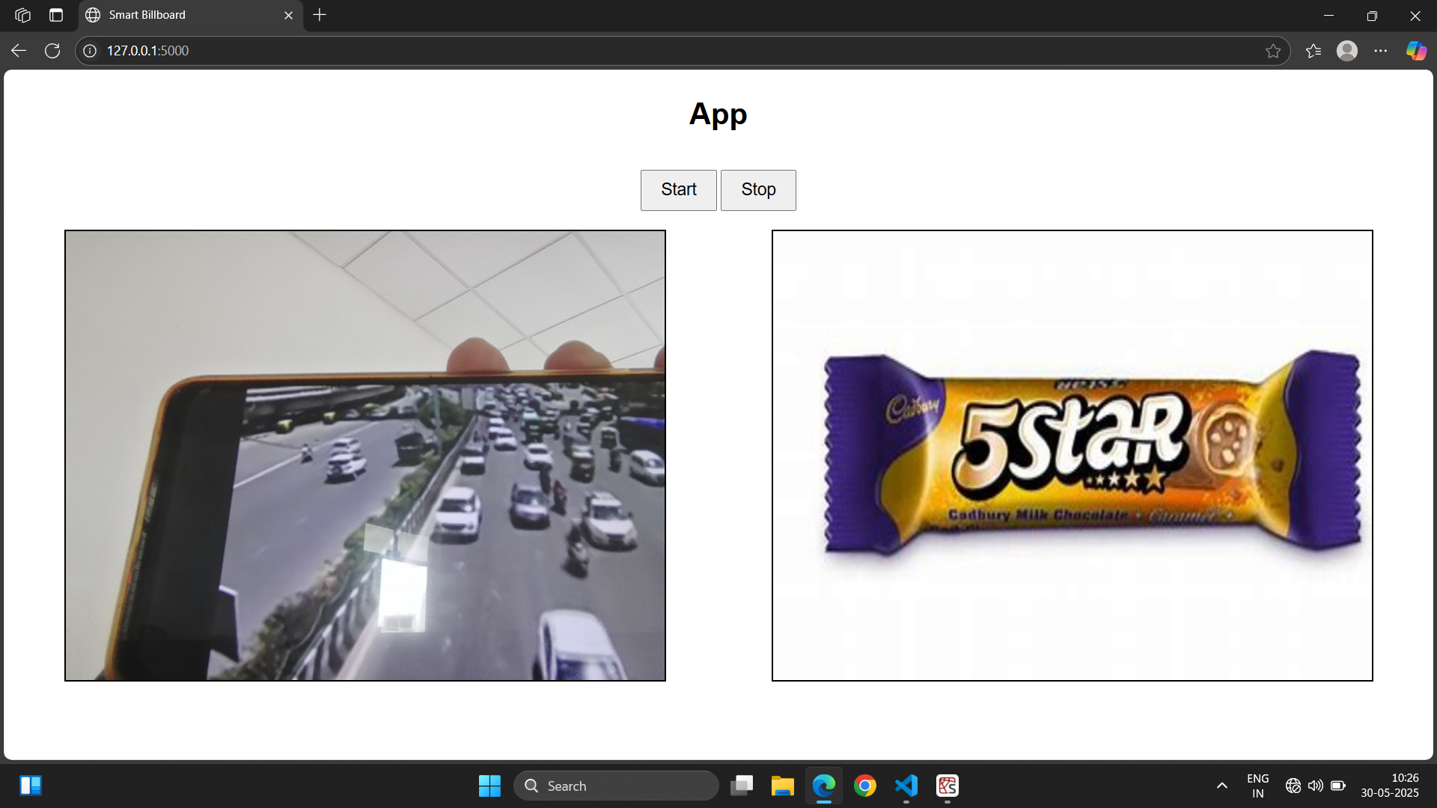
Results (Screenshots)

Slide 17
reference
1. A. Bochkovskiy, C.-Y. Wang, and H.-Y. M. Liao, “YOLOv4: Optimal speed and accuracy of object detection,” *arXiv preprint arXiv:2004.10934*, Apr. 2020. \[Online]. Available: [https://arxiv.org/abs/2004.10934](https://arxiv.org/abs/2004.10934)
2. J. Redmon and A. Farhadi, “YOLOv3: An incremental improvement,” *arXiv preprint arXiv:1804.02767*, Apr. 2018. \[Online]. Available: [https://arxiv.org/abs/1804.02767](https://arxiv.org/abs/1804.02767)
3. V. N. Ribeiro and N. S. T. Hirata, “Combining YOLO and Visual Rhythm for Vehicle Counting,” *arXiv preprint arXiv:2501.04534*, Jan. 2025. \[Online]. Available: [https://arxiv.org/abs/2501.04534](https://arxiv.org/abs/2501.04534)
4. Y. Liu, H. Shen, T. Wang, and G. Bai, “Vehicle Counting in Drone Images: An Adaptive Method with Spatial Attention and Multiscale Receptive Fields,” *ETRI Journal*, vol. 45, no. 2, pp. 234–244, 2023. \[Online]. Available: [https://onlinelibrary.wiley.com/doi/10.4218/etrij.2023-0426](https://onlinelibrary.wiley.com/doi/10.4218/etrij.2023-0426)
5. K. A. Redmill et al., “Automated Traffic Surveillance Using Existing Cameras on Transit Buses,” *Sensors*, vol. 23, no. 11, p. 5086, 2023. \[Online]. Available: [https://www.mdpi.com/1424-8220/23/11/5086](https://www.mdpi.com/1424-8220/23/11/5086)

Slide 18
reference
6. Z. Černeková et al., “Evaluating the Significance of Outdoor Advertising from Driver’s Perspective Using Computer Vision,” *arXiv preprint arXiv:2311.07390*, Nov. 2023. \[Online]. Available: [https://arxiv.org/abs/2311.07390](https://arxiv.org/abs/2311.07390)
7. M. Everingham et al., “The PASCAL Visual Object Classes (VOC) Challenge,” *International Journal of Computer Vision*, vol. 88, no. 2, pp. 303–338, Jun. 2010. \[Online]. Available: [https://link.springer.com/article/10.1007/s11263-009-0275-4](https://link.springer.com/article/10.1007/s11263-009-0275-4)
8. T.-Y. Lin et al., “Microsoft COCO: Common Objects in Context,” in *European Conference on Computer Vision (ECCV)*, 2014, pp. 740–755. \[Online]. Available: [https://arxiv.org/abs/1405.0312](https://arxiv.org/abs/1405.0312)
9. M. Tan and Q. Le, “EfficientNet: Rethinking model scaling for convolutional neural networks,” in *Proc. ICML*, 2019. \[Online]. Available: [https://arxiv.org/abs/1905.11946](https://arxiv.org/abs/1905.11946)
10. H. Wang et al., “Deep Learning for Object Detection: A Comprehensive Review,” *IEEE Transactions on Neural Networks and Learning Systems*, vol. 32, no. 9, pp. 4031–4052, Sept. 2021. \[Online]. Available: [https://ieeexplore.ieee.org/document/9390379](https://ieeexplore.ieee.org/document/9390379)

Slide 19
Conclusion:
The project "Revolutionizing Ads with Mobile Vehicles Campaigns" presents a smart and adaptive solution for modern advertising using real-time traffic data. By combining computer vision with deep learning (YOLOv8), the system detects and counts vehicles from a live camera feed and automatically selects the most suitable advertisement based on traffic density. This approach makes mobile advertising more dynamic, targeted, and efficient. It not only improves engagement by showing relevant ads to the right audience but also introduces a cost-effective and scalable model for outdoor campaigns. Overall, the system brings innovation to traditional billboard advertising and shows great potential for future smart city applications.

